Slide 1


European Solidarity under Strain? Political Divides over Russia and Ukraine in Europe
Dietlind Stolle,
Maria Popova,
Rafael Campos-Gottardo
(McGill University)
Notes:
NOT FOR DISSEMINATION

Slide 2
Our Arguments in a Nutshell
1) Cleavages are based on individual's belief systems, identities or political conflicts
3) The war against Ukraine represents conflict deeply rooted in the history of Europe and its relationship with Russia (liberal vs illiberal) easily forming a collaboration-security division.
2) External threats might be utilized to transform salient foreign policy issues into structured belief systems.
4) Most Europeans take a position on this dimension. It cuts across existing cleavages and has political consequences. We explore whether the collaboration-security division represents a new political cleavage in Europe.

Slide 3
The potency of the Europe-Russia cleavage
Modern cleavages are based on individuals’ belief systems (Brandt et al. 2021; Zuckerman, 1975).
External threats increase salience for security and foreign policy concerns (Huddy et al. 2005; Gadarian 2010; Gelpi, Feaver, and Reifler 2009).
Sustained threats and crises can amplify existing dimensions of conflict.
Europe has constructed itself as liberal and democratic, while Russia is constructed as an illiberal “Other” (Neumann 1996, Rumelili 2004, Vachudova 2005, Zarakol 2011, DeBardeleben 2012).

Slide 4
Expectations
E1) Europeans will take a position on the Russo-Ukrainian war along a security–collaboration dimension.
E2) Horizontal coherence within the issue domain around the Russo-Ukrainian war.
E3) Vertical extension of the security-collaboration dimension into a broader worldview.
E4) The security–collaboration cleavage will cut across other prominent cleavages.
E5) This dimension has political relevance and consequences.

Slide 5
Data
EUI YouGov Solidarity in Europe Study (2022, 2023, 2024, and 2025 waves).
1,000 to 2,000 respondents per country across 22 countries (N = 96,619).
2022 Countries: UK, Denmark, Greece, Hungary, Lithuania, Italy Poland, Netherlands, Romania, Slovakia, Croatia, Bulgaria, Spain, Finland, France, Germany, Sweden.
2024: 2022 + Belgium.
2025: 2024 + Portugal, Slovenia, Czechia, Ireland.

Slide 6
Operationalization
Three survey items are used to operationalize the security-collaboration dimension.
Thinking about the European Union’s relationship with Russia, which approach would you prefer European countries to take? (Defence and security, trade and diplomacy, neither of these).
Support for sending weapons and military equipment to Ukraine.
Willingness to accept higher energy costs due to sanctions.
Factor analysis to develop a continuous score
Additional key variables fur further analysis include: left-right ideological self-placement, the GAL-TAN dimension, and vote choice.

Slide 7
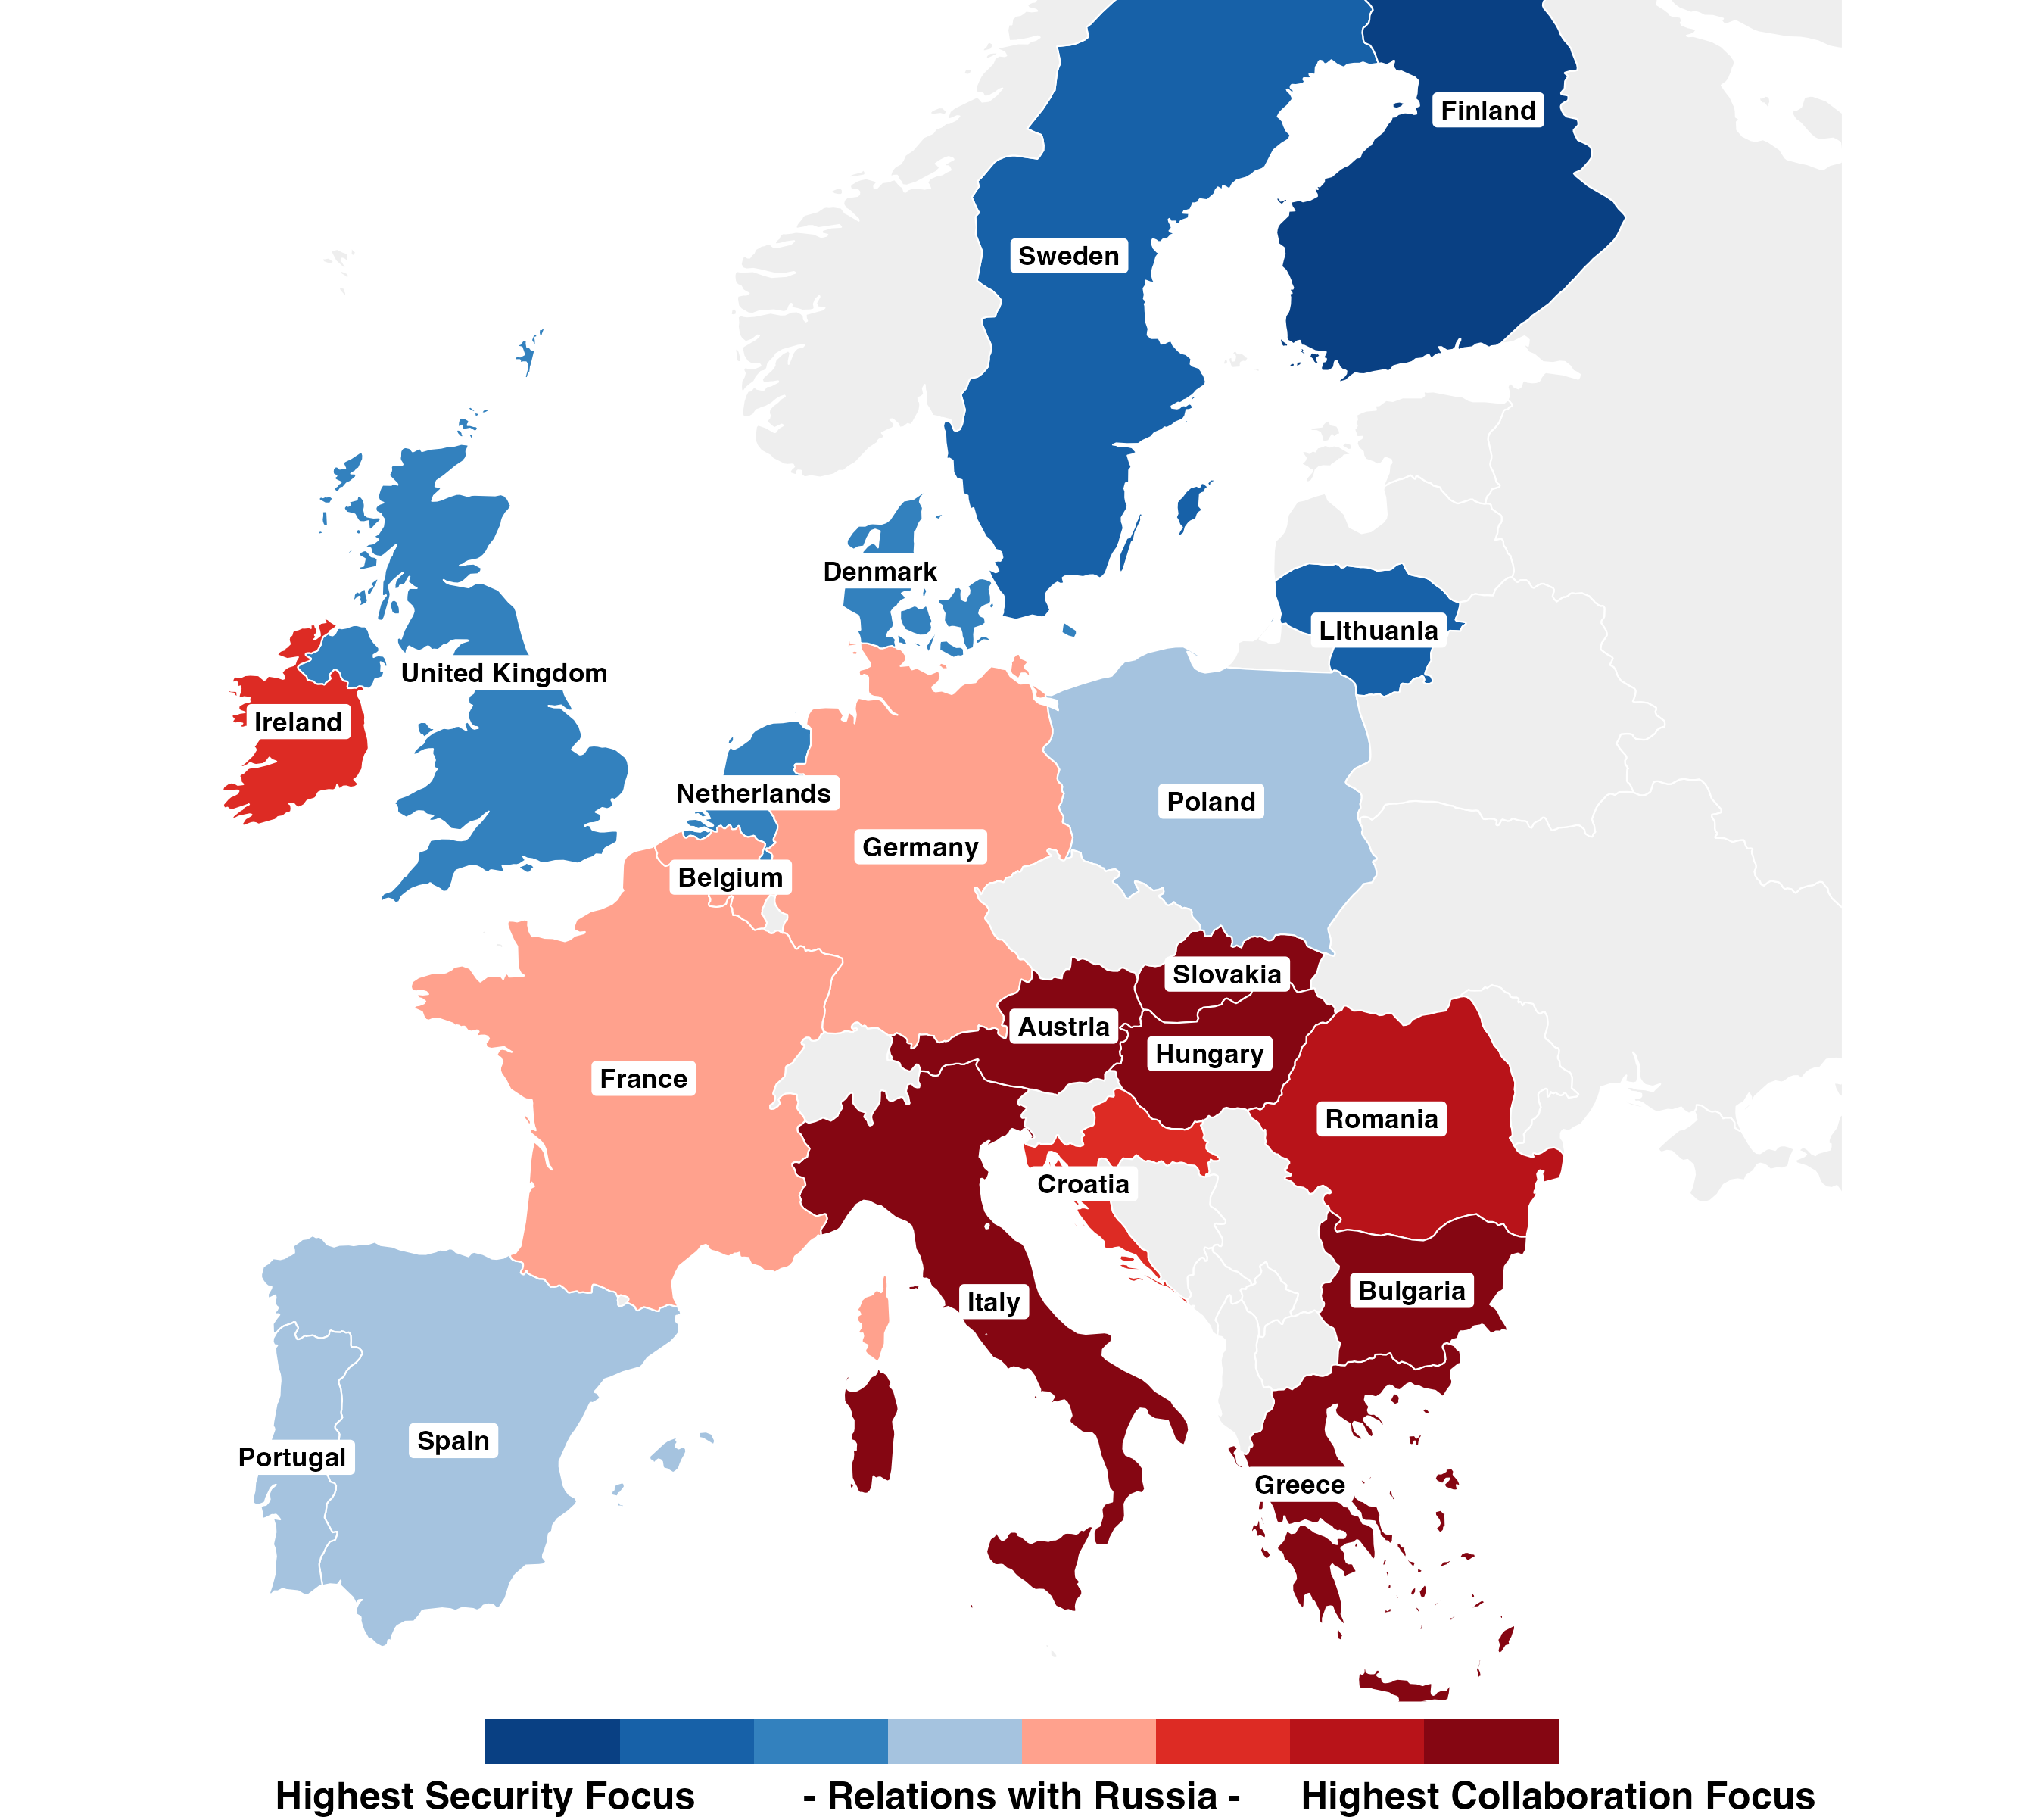
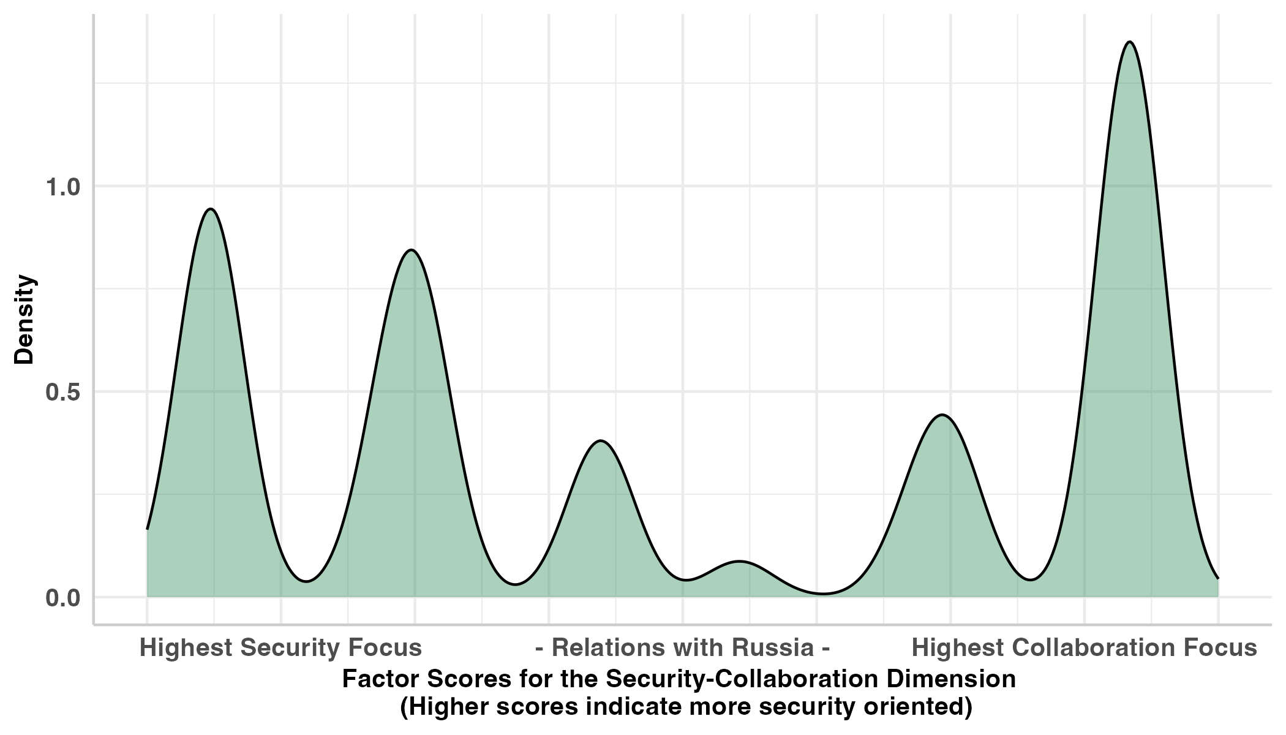
The Security-Collaboration Dimension
EU Relationship with Russia
Military Aid to Ukraine
Accept Higher Energy Costs
Includes all years

Slide 8
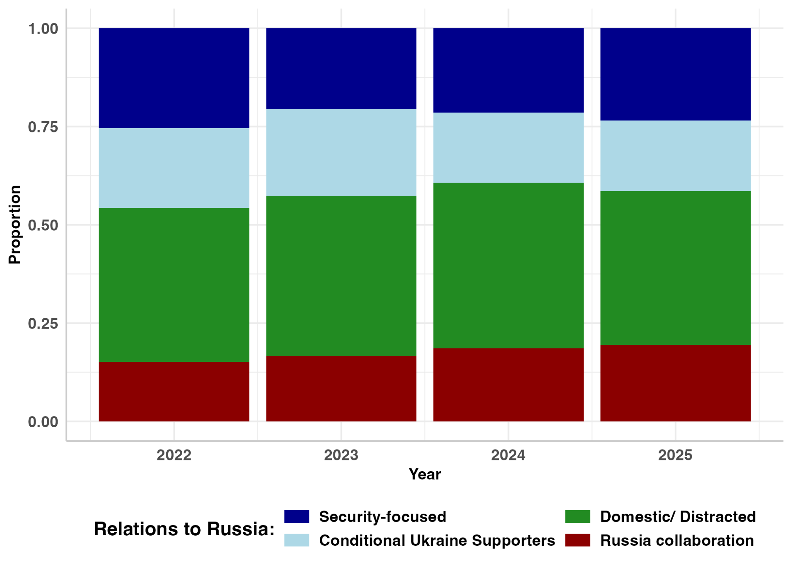
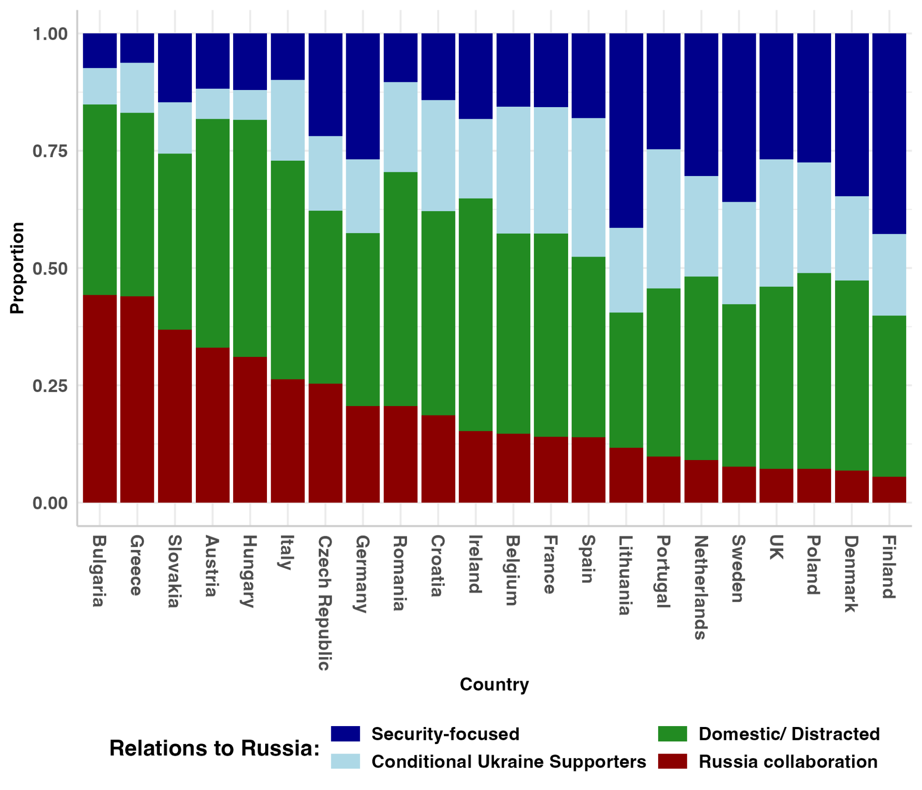
Groupings

Slide 9
Results

Slide 10
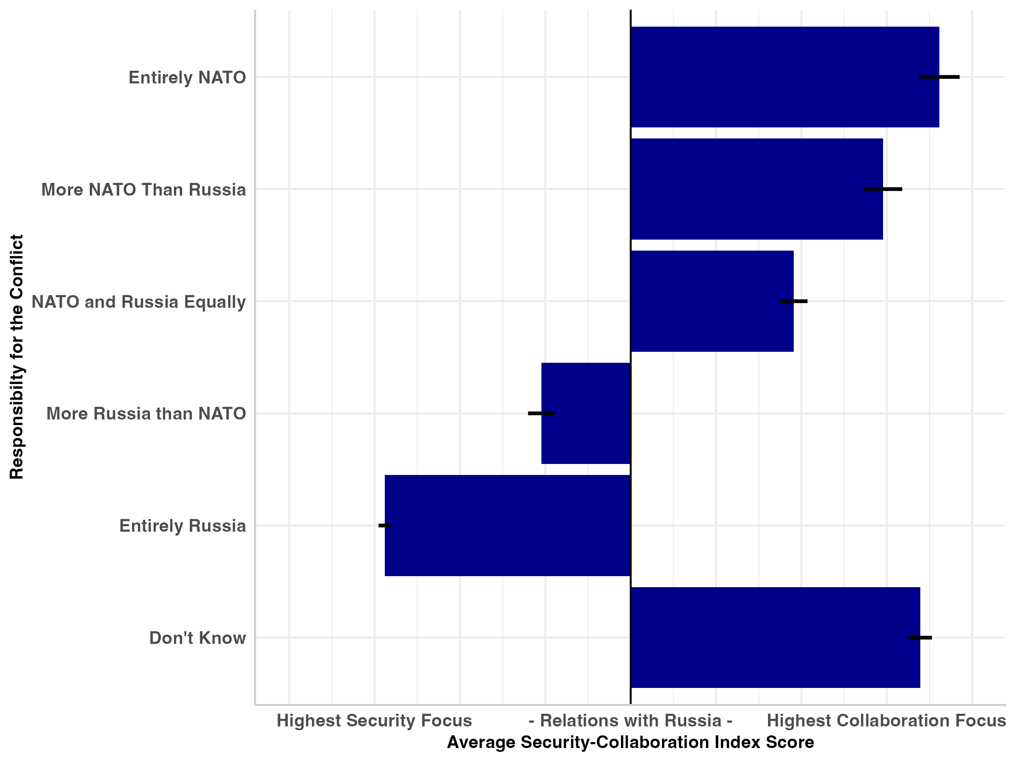
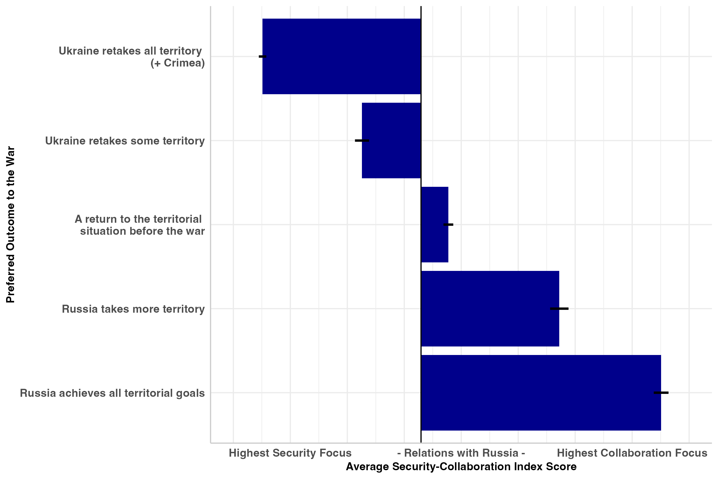
Expectation 2: Horizontal Coherence
Notes:
Mean value of security-collaboration index for each group.

Slide 11
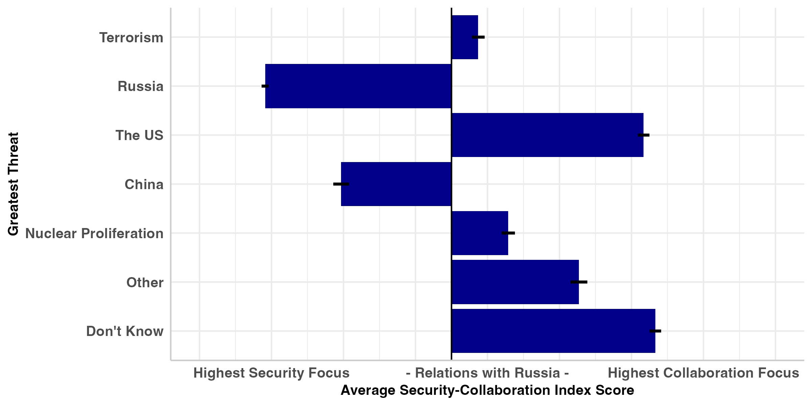
Expectation 2: Horizontal Coherence
Notes:
Mean value of security-collaboration index for each group.

Slide 12
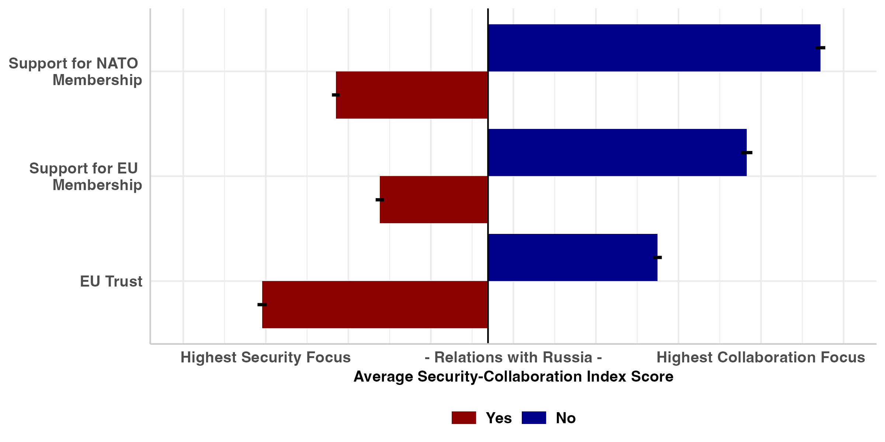
Expectation 3: Vertical Extension
Notes:
Mean value of security-collaboration index for those who support NATO and EU and NATO membership and those who do not and those who trust the EU and those who do not.

Slide 13
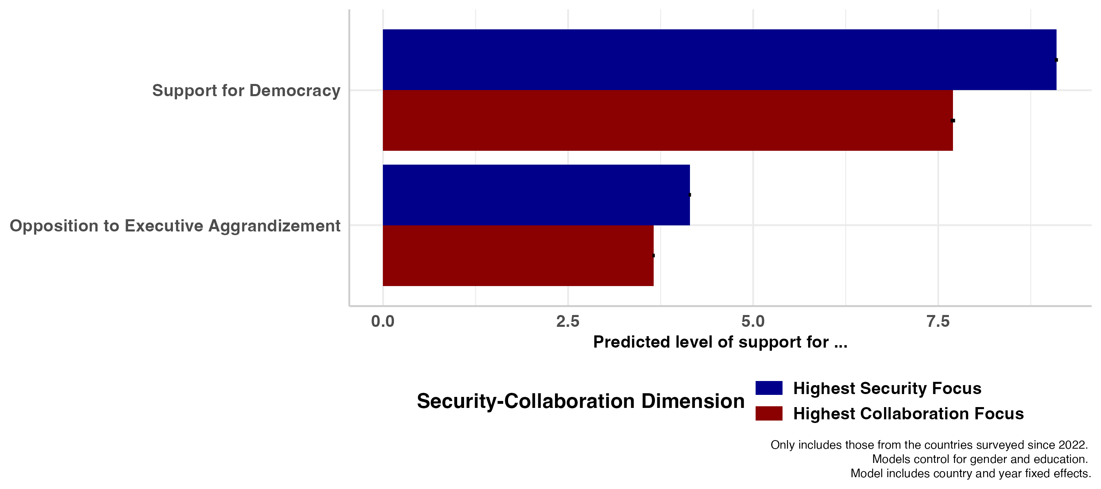
Expectation 3: Vertical Extension
Notes:
Mean value of security-collaboration index for those who support NATO and EU and NATO membership and those who do not and those who trust the EU and those who do not.

Slide 14
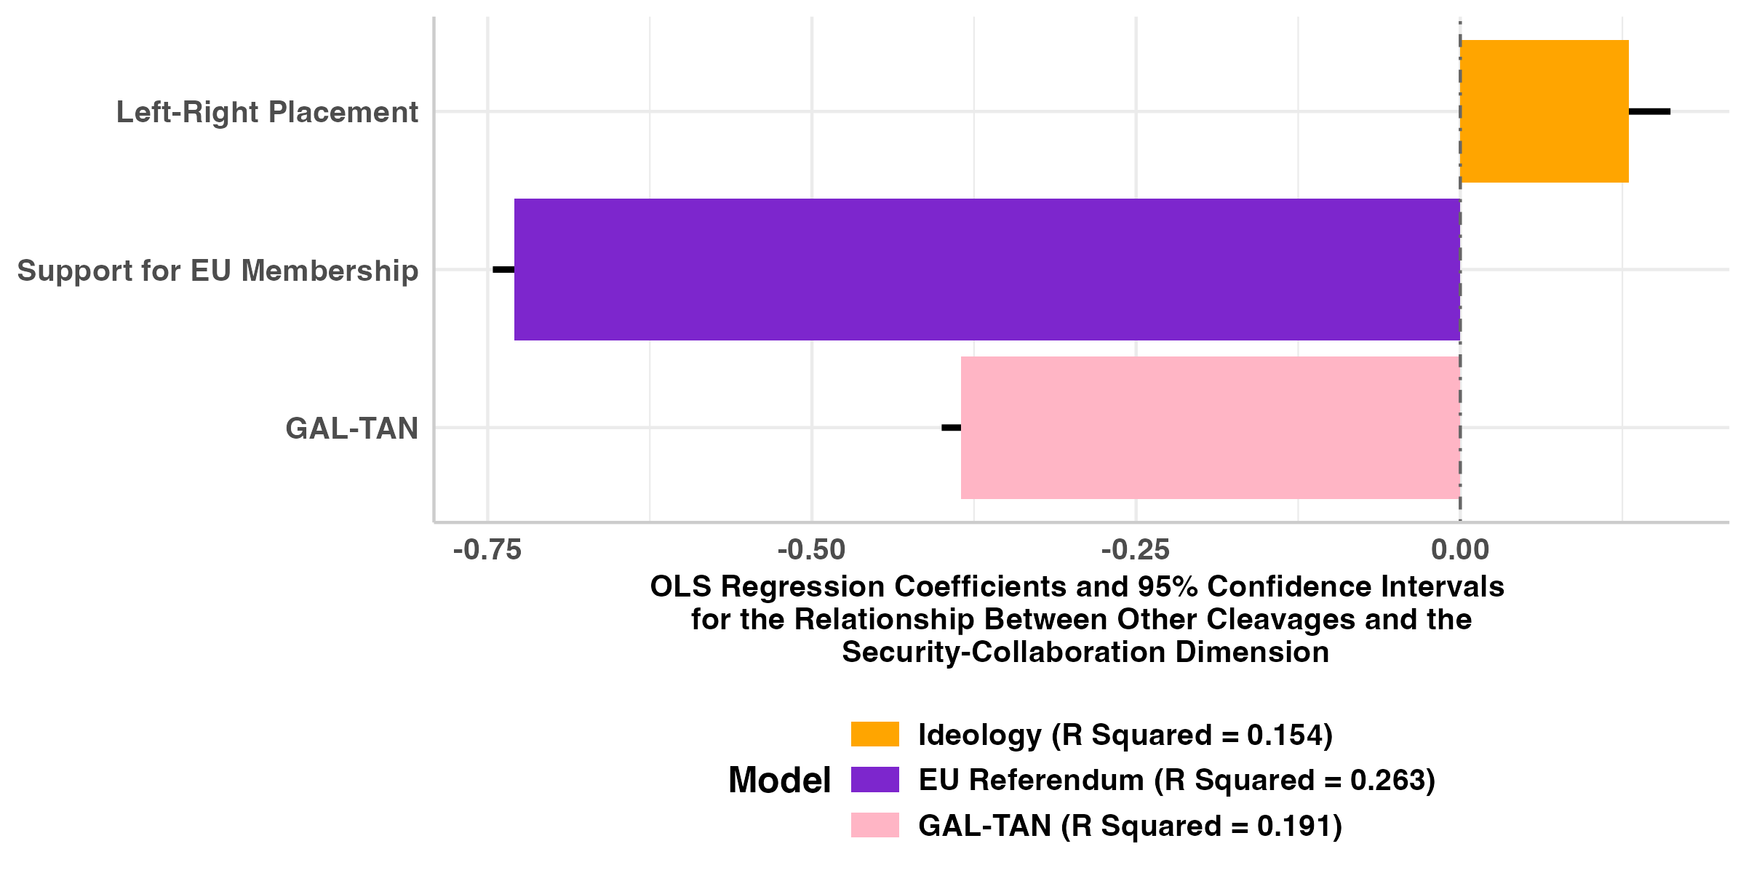
Expectation 4: Cuts Across Existing Cleavages
Notes:
Regression model: Key variable + Gender + Education + country fixed effects + year fixed effects.
All variables are scaled from 0-1 Support for EU membership, vote to stay (1) vote to leave (0)
Left-right Most right-wing position (1) most left—wing position (0)
GAL-TAN Most Gal position (1) Most TAN position (0)

Slide 15
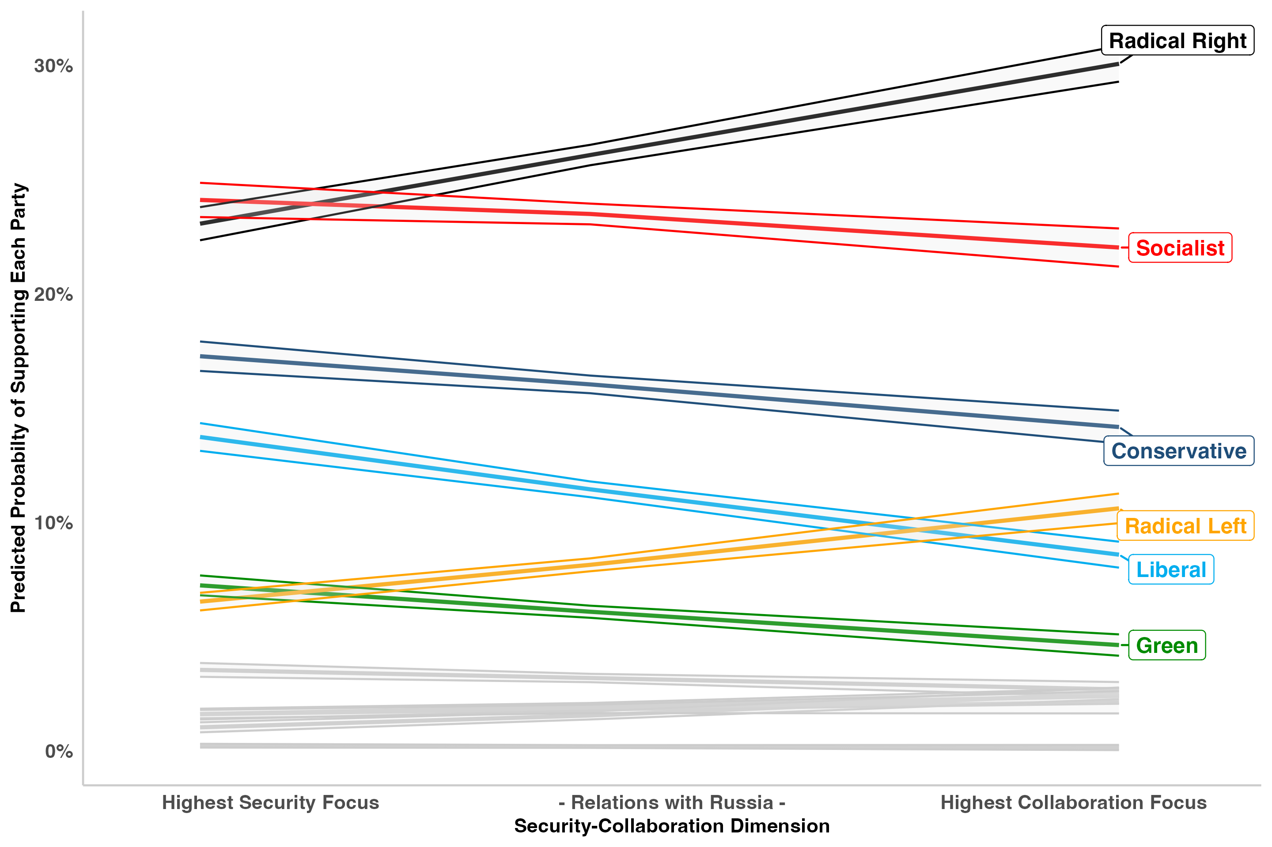
Expectation 5: Political Consequences
Notes:
Full Model: Security-Collaboration Factor, Left-Right self placement, EU membership, GAL-TAN, gender, education, country and year fixed effects
Slopes:
Radical Right: 0.03 (p < 0.001)
Radical Left: 0.015 (p < 0.001)
Conservative: -0.011 (p < 0.001)
Liberal: -0.019 (p < 0.001)
Socialist: -0.007 (p – 0.003)

Slide 16
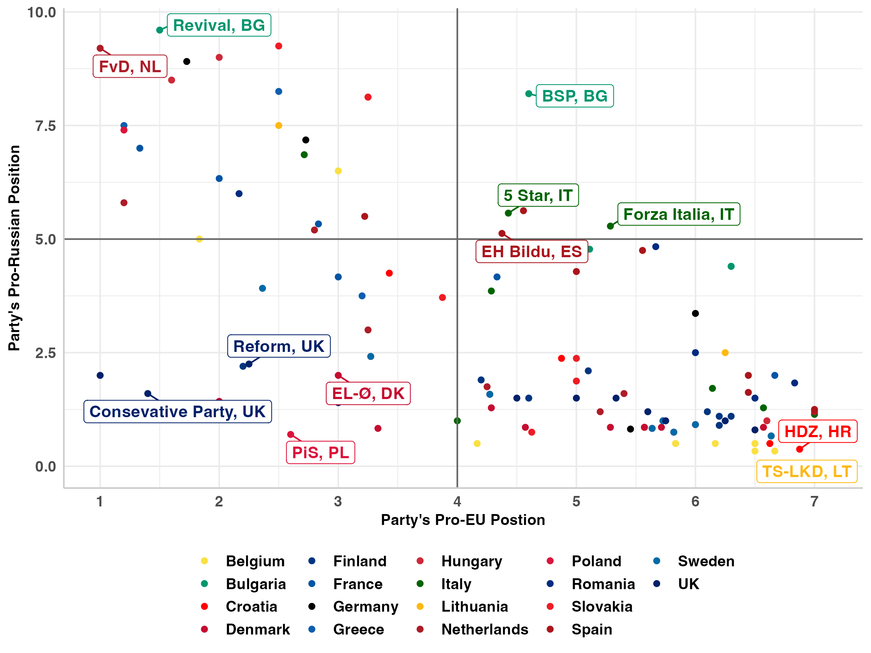
Party Positions
Notes:
Average Security-collaboration score for supporters of each party and kremlin ties of each party from 2023 Ukraine Special CHES

Slide 17
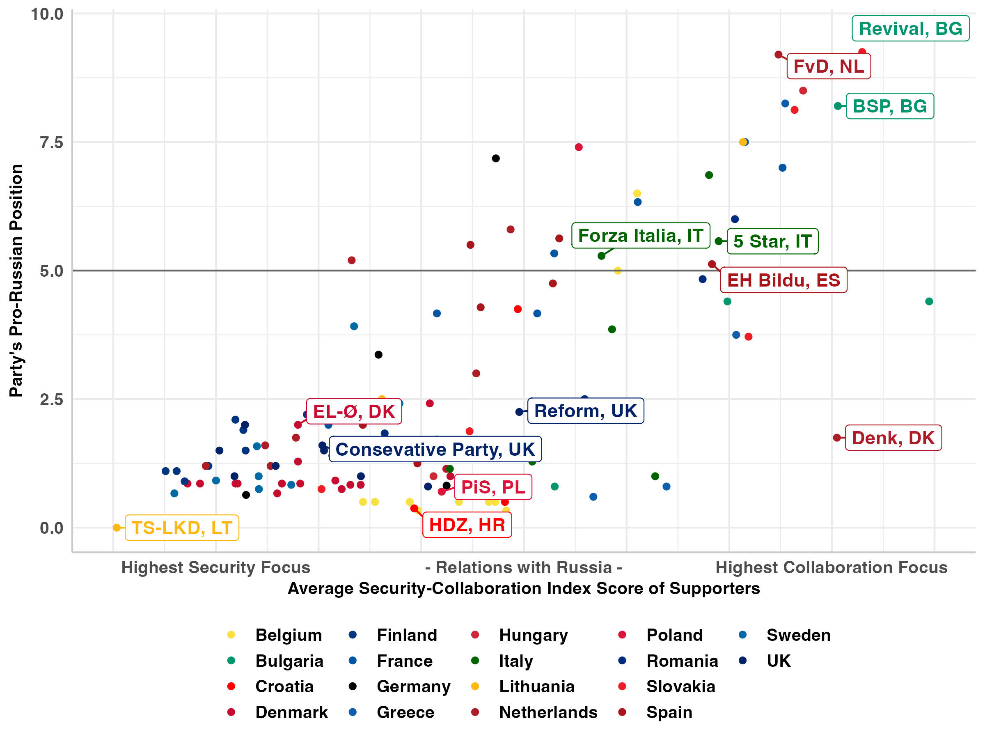
Party Positions
Notes:
EU position and kremlin ties of each party from the 2023 Ukraine special CHES

Slide 18
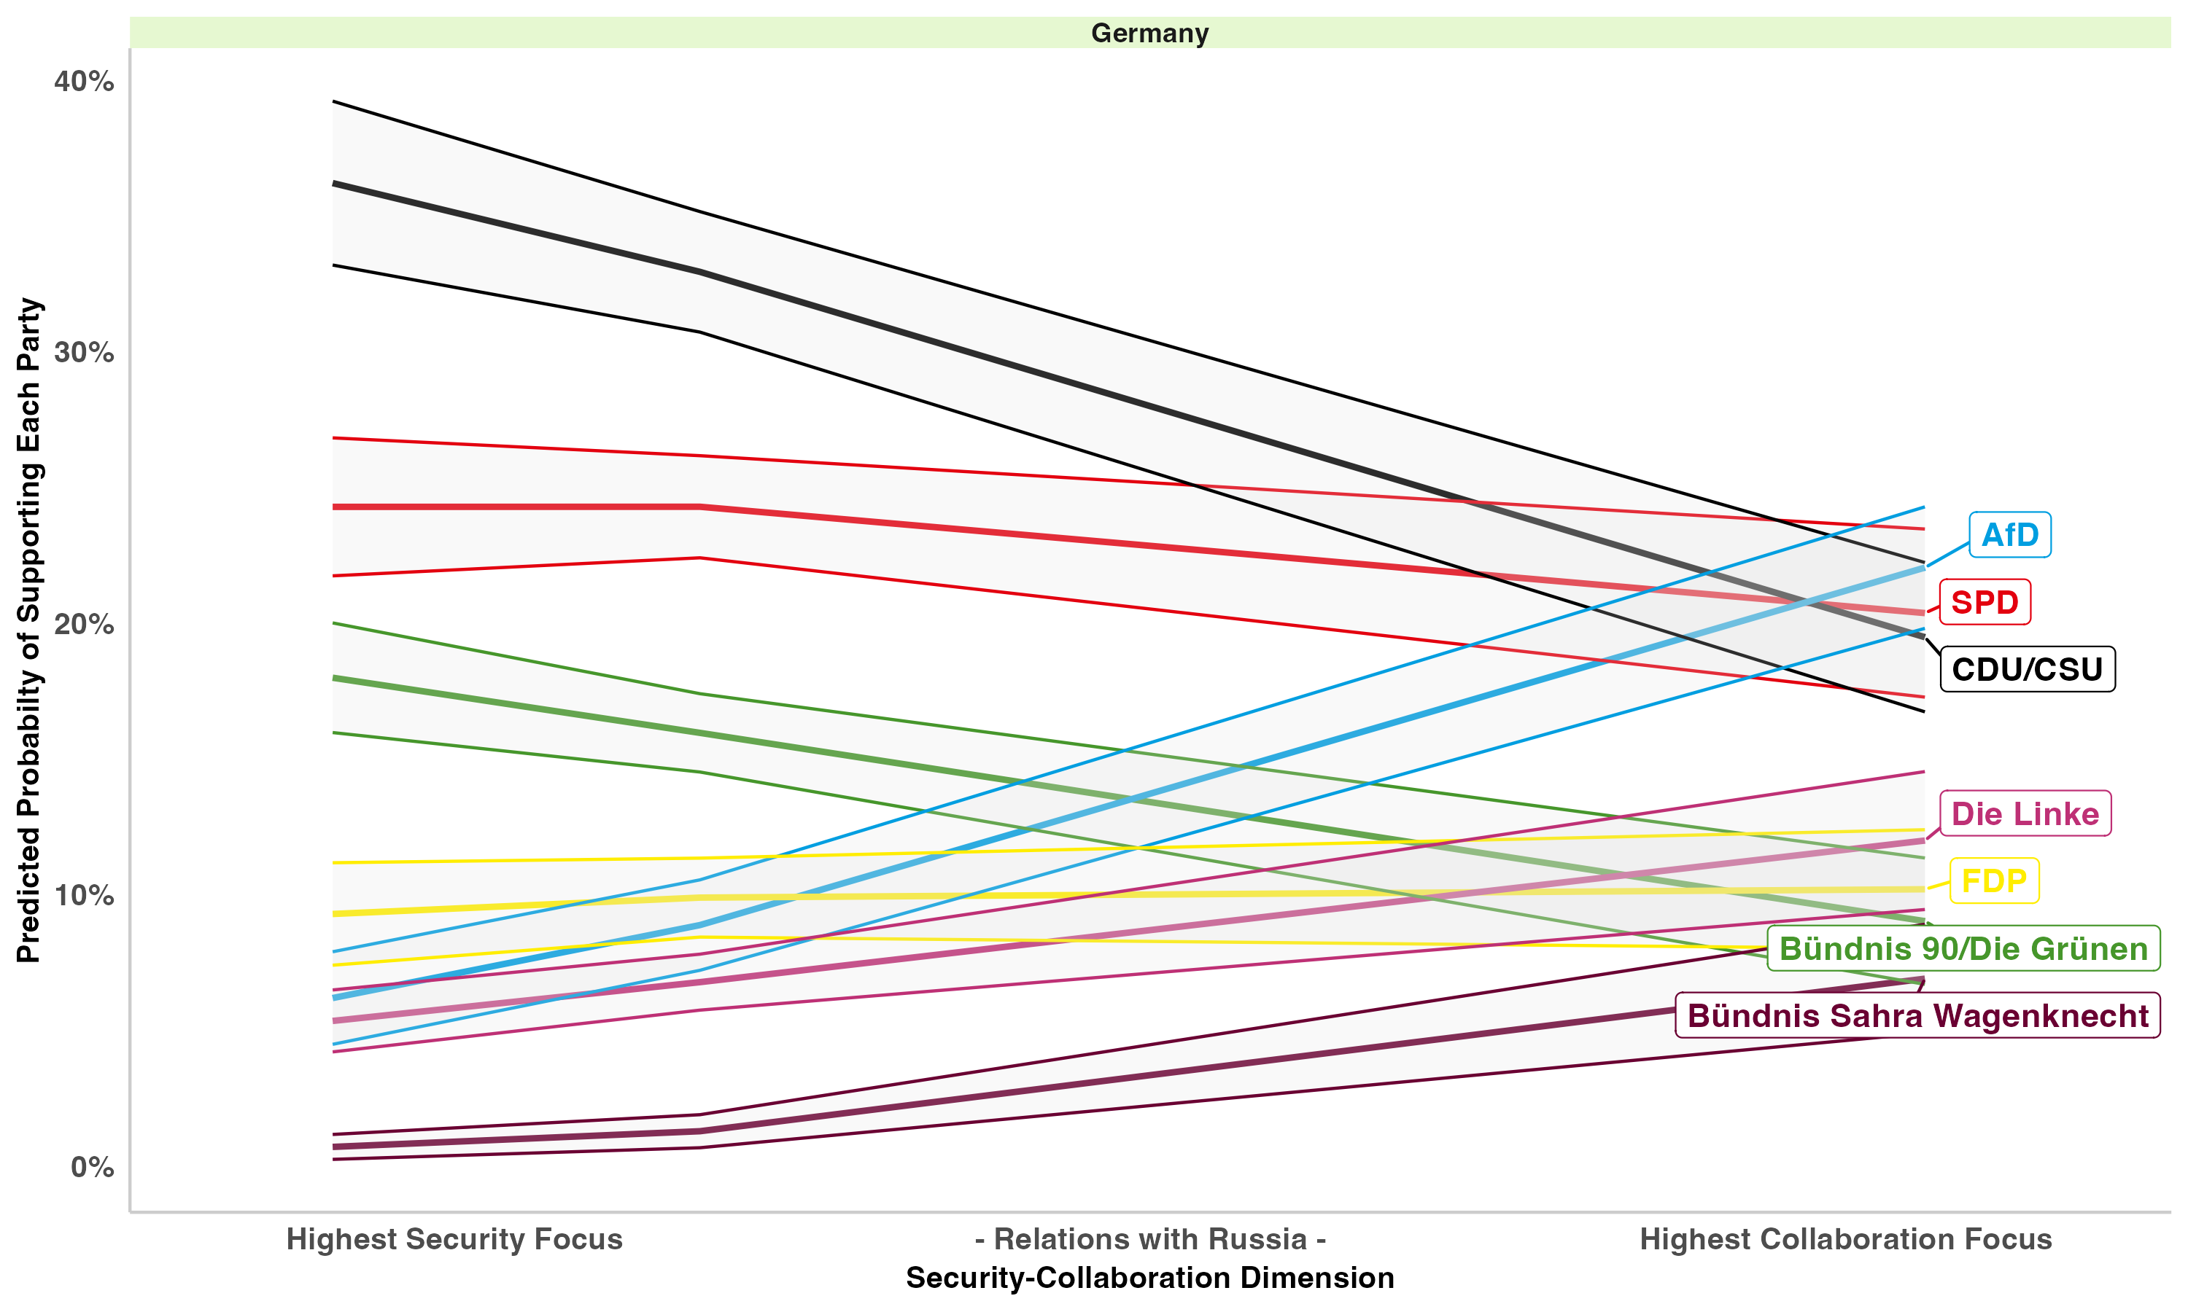
Expectation 5: Political Consequences
Notes:
Full Model: Security-Collaboration Factor, Left-Right self placement, EU membership, GAL-TAN, gender, education, year fixed effects

Slide 19
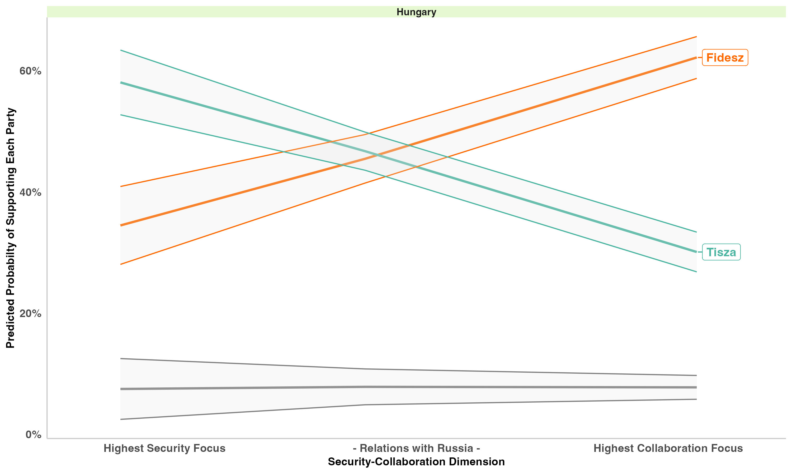
Expectation 5: Political Consequences
Notes:
Full Model: Security-Collaboration Factor, Left-Right self placement, EU membership, GAL-TAN, gender, education, year fixed effects

Slide 20
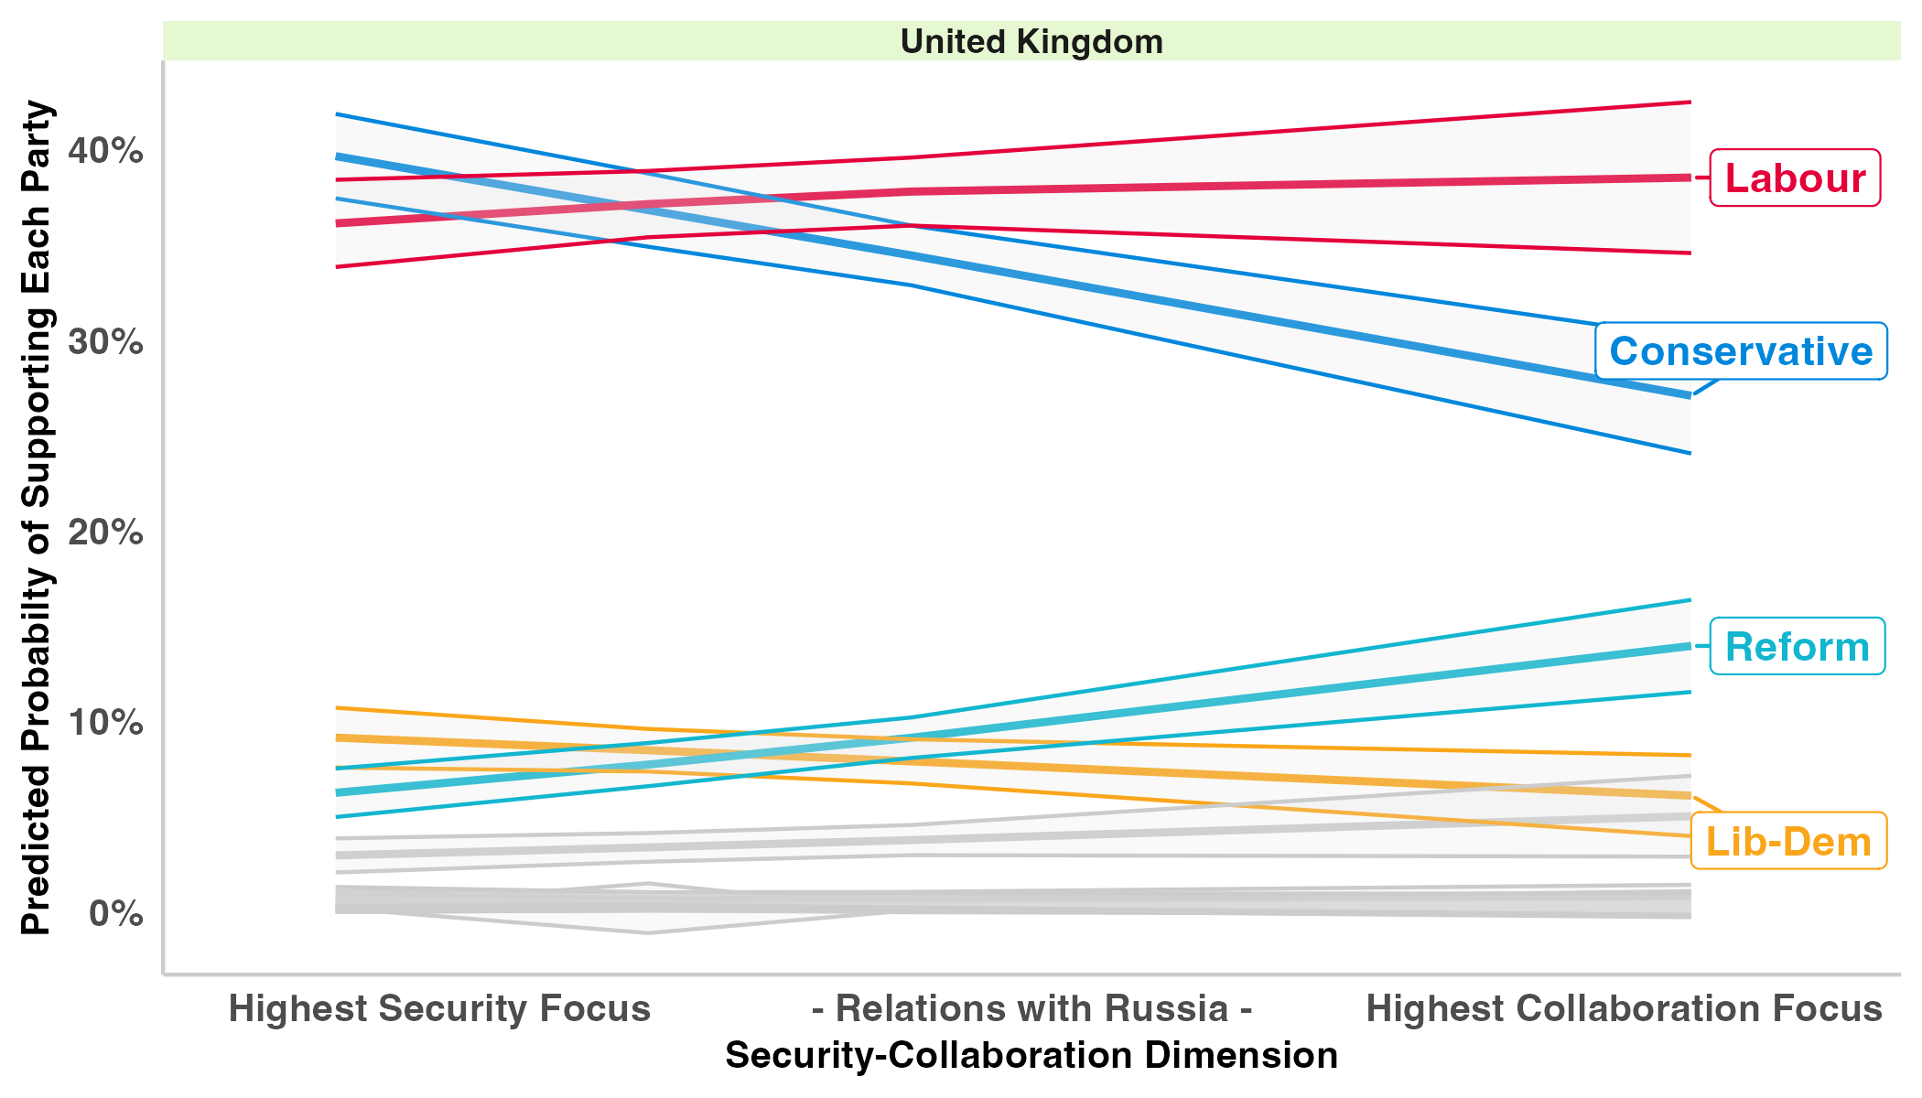
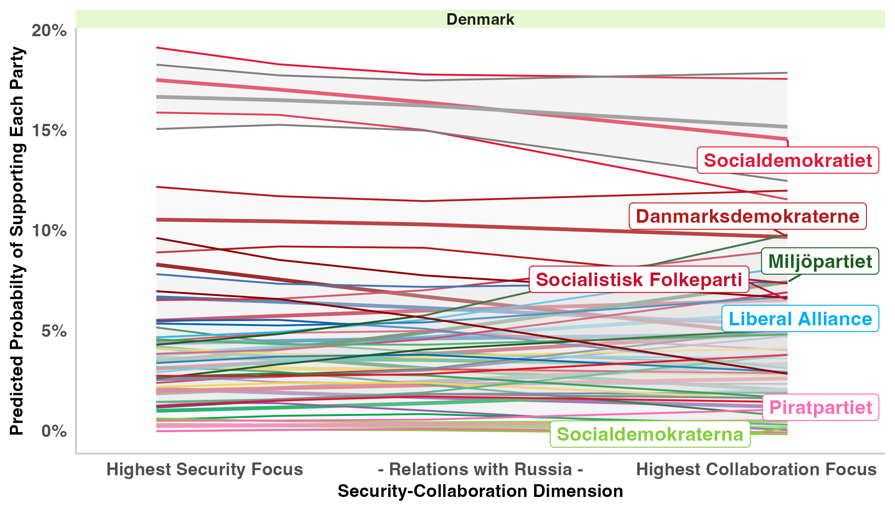
Expectation 5: Political Consequences
Notes:
Full Model: Security-Collaboration Factor, Left-Right self placement, EU membership (not UK), GAL-TAN, gender, education, year fixed effects

Slide 21
Conclusion
Most Europeans have a position on the security-accommodation dimension.
Europeans’ position on the security-collaboration dimension is associated with their views on foreign policy issues, NATO, the European Union, and democracy.
While correlated with the left-right and GAL-TAN dimensions, the security-accommodation dimension independently predicts support for pro-Russian parties and pro-EU parties as well as the vote for various party families.

Slide 22
Appendix

Slide 23
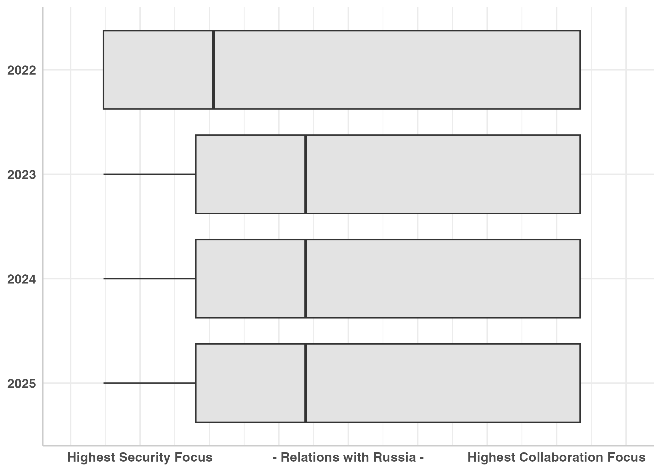
Collaboration-Security Dimension
Includes all years

Slide 24
What is a Cleavage?
Political conflict is organized along enduring lines.
Social-structural divisions that differentiate societal groups.
Contain a corresponding set of structured attitudes.
Express themselves in political alignment and competition (Lipset and Rokkan 1967).
Modern cleavages are based on individuals’ belief systems.
Belief systems structure how individuals interpret the political world.
Modern cleavages include, left-right, urban-suburban, pro-anti-EU, GAL-TAN
Issues and Ideas
Belief systems
Political Actors

Slide 25
Factor Analysis: Collaboration Security Measure
All three items dichotomized with 1 as the Pro-Security position
Tetrachoric factor analysis
Eigen values: 2.224; 0.526; 0.249
Alpha = 0.68
Final variable is reversed so the higher the value the higher the respondent’s collaboration focus.
Variable | Loadings
EU Relationship with Russia | 0.676
Military Aid to Ukraine | 0.984
Accept Higher Energy Costs | 0.702
SS Loadings | 1.917
Proportion Variation | 0.639

Slide 26
Grouping Variable
Support Military Aid to Ukraine
European Countries should invest in trade and diplomacy
Domestic Distracted
Russian Collaborator
Willing to Accept Higher Energy Costs
Conditional Ukraine Support
European countries should invest in defence and security
Domestic Distracted
Security Focused
No
Yes
No
Yes
No
Yes
No
Yes

Slide 27
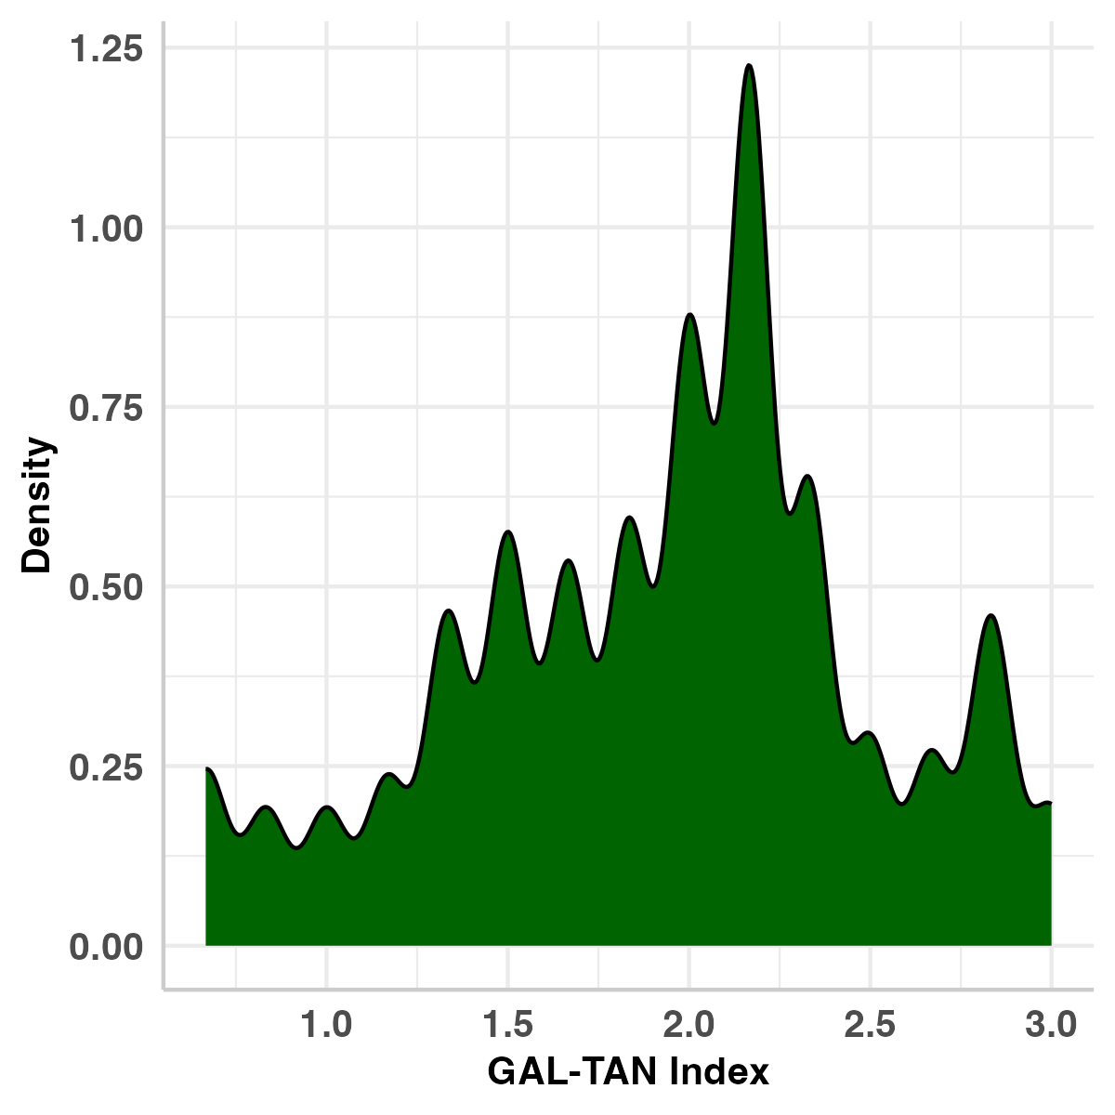
GAL-TAN Measure
6 item additive index all dichotomous variables:
Climate chosen as one of respondents’ most important issues
Support immigrants from country’s ethnic group
Support immigrants from a different ethnic group
Support immigrants from poorer countries in the EU
Support immigrants from poorer countries outside the EU
alpha = 0.83

Slide 28
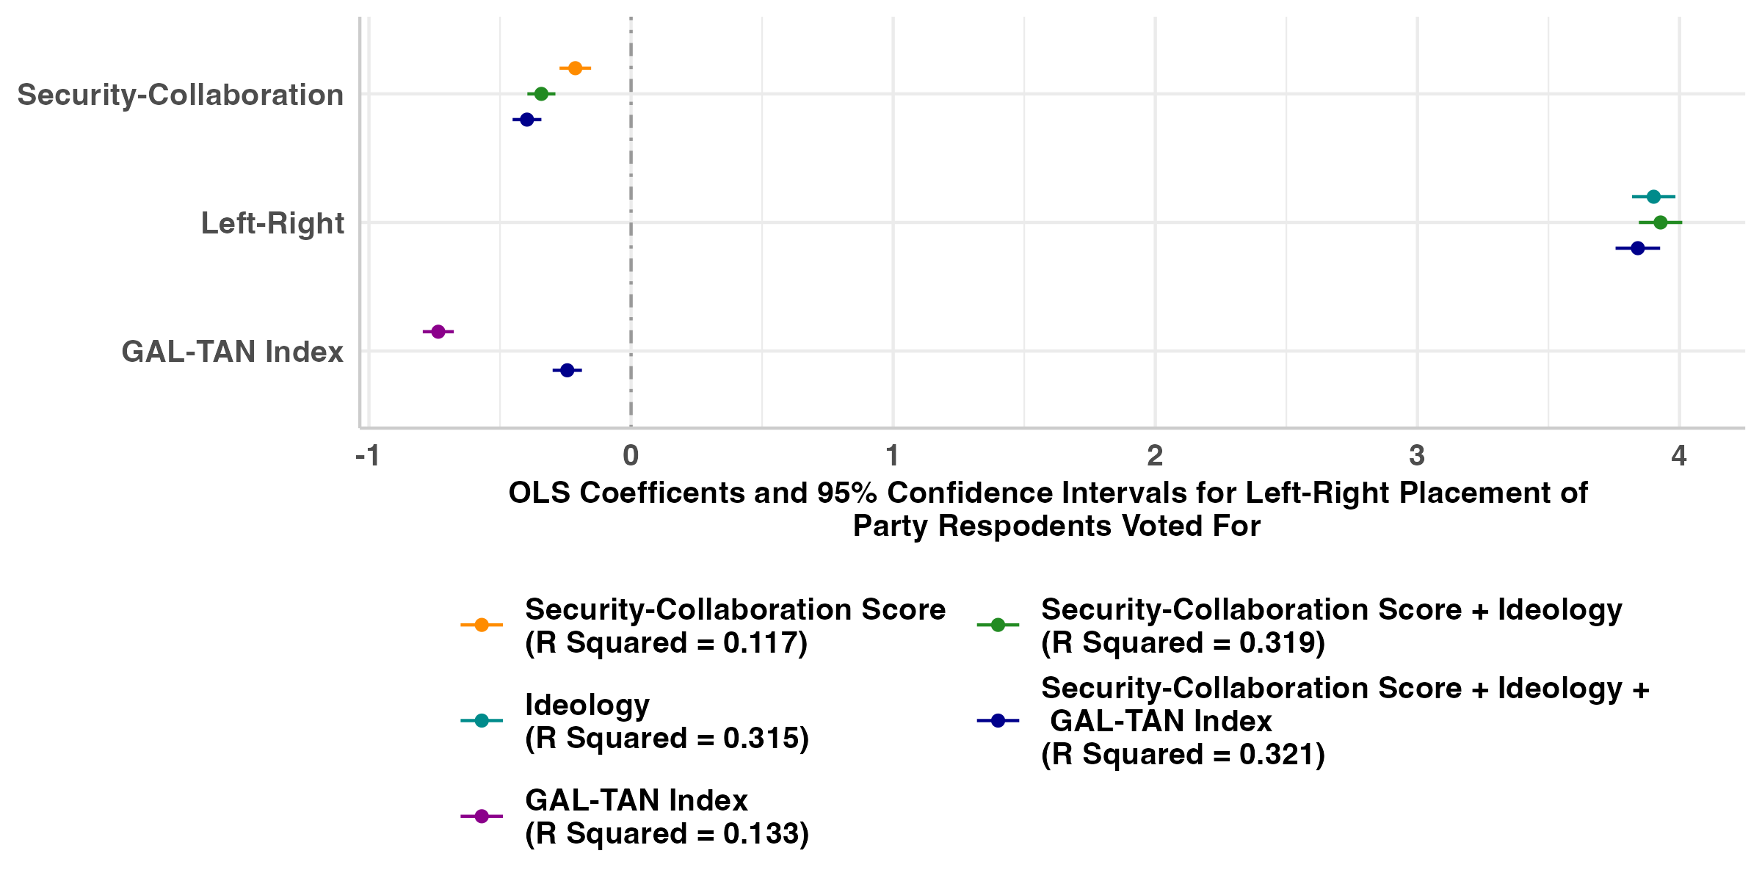
Expectation 4: Left-Right Placement

Slide 29
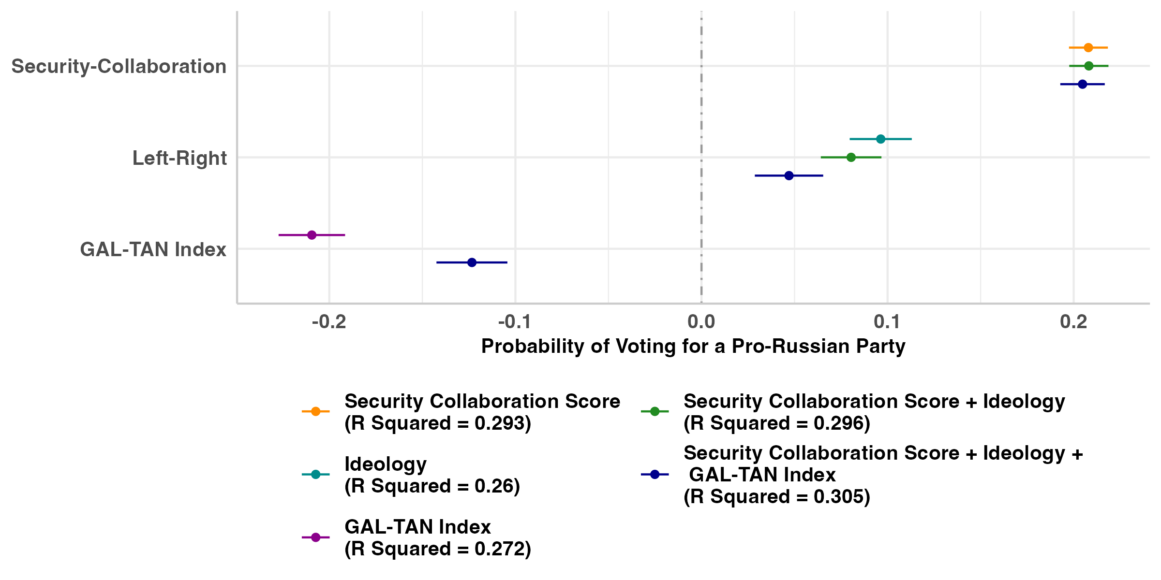
Expectation 4: Pro-Russian Parties

Slide 30
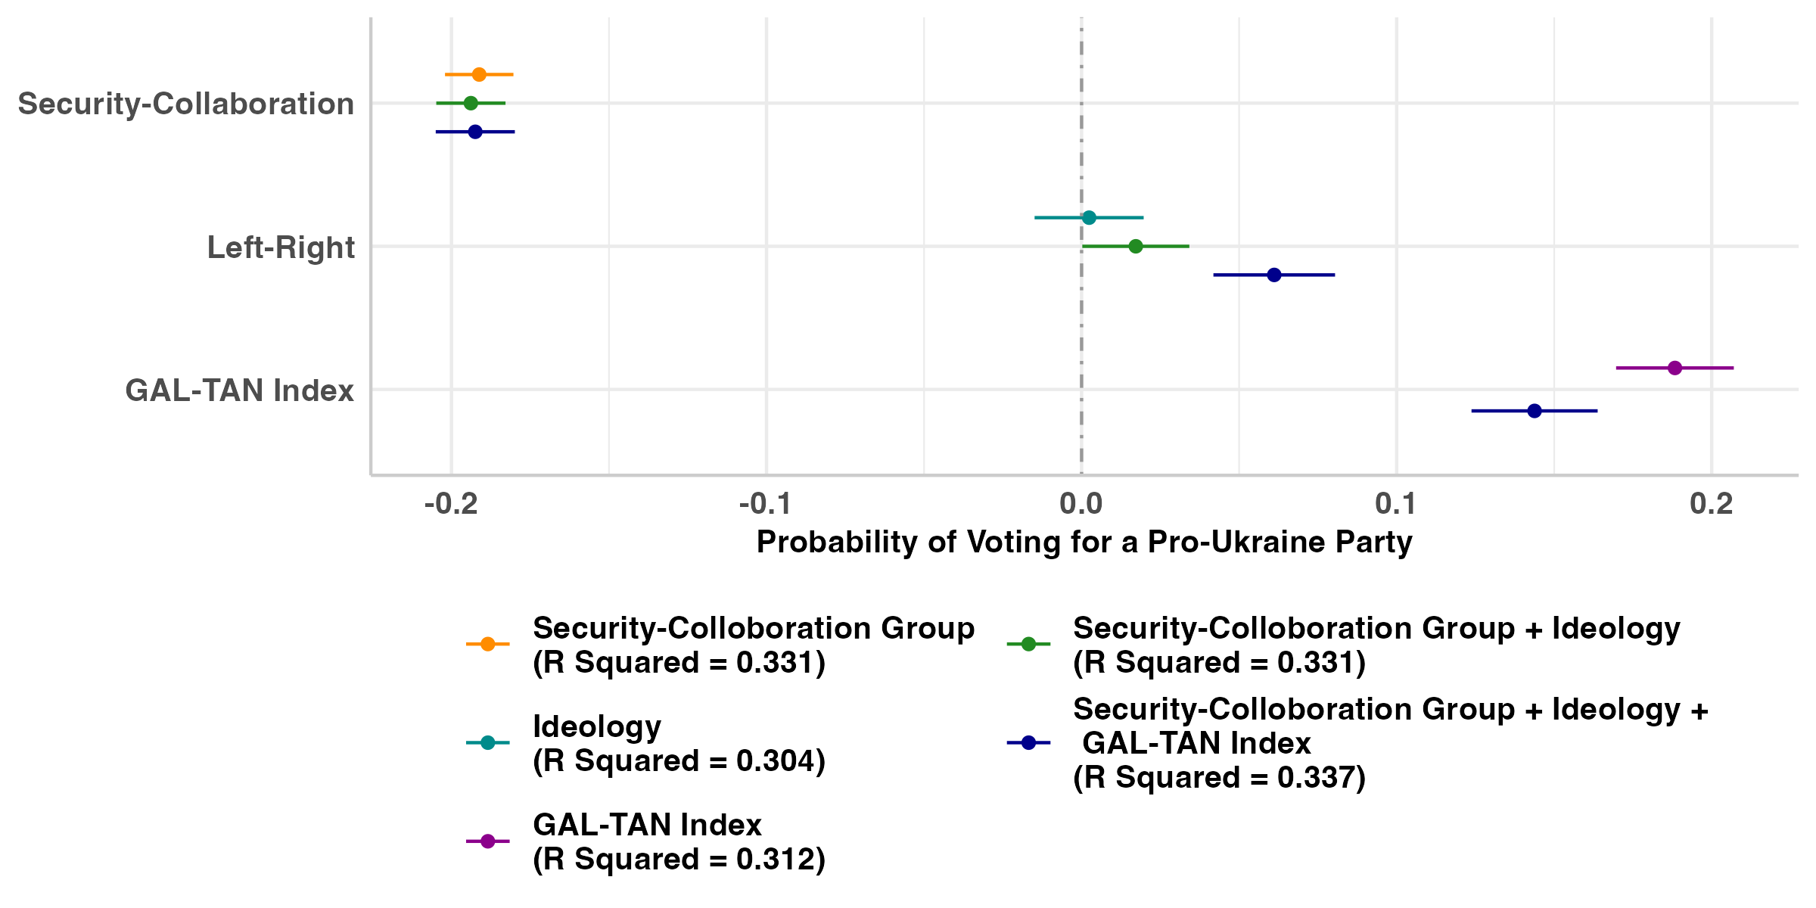
Expectation 4: Pro-Ukraine Parties

Slide 31
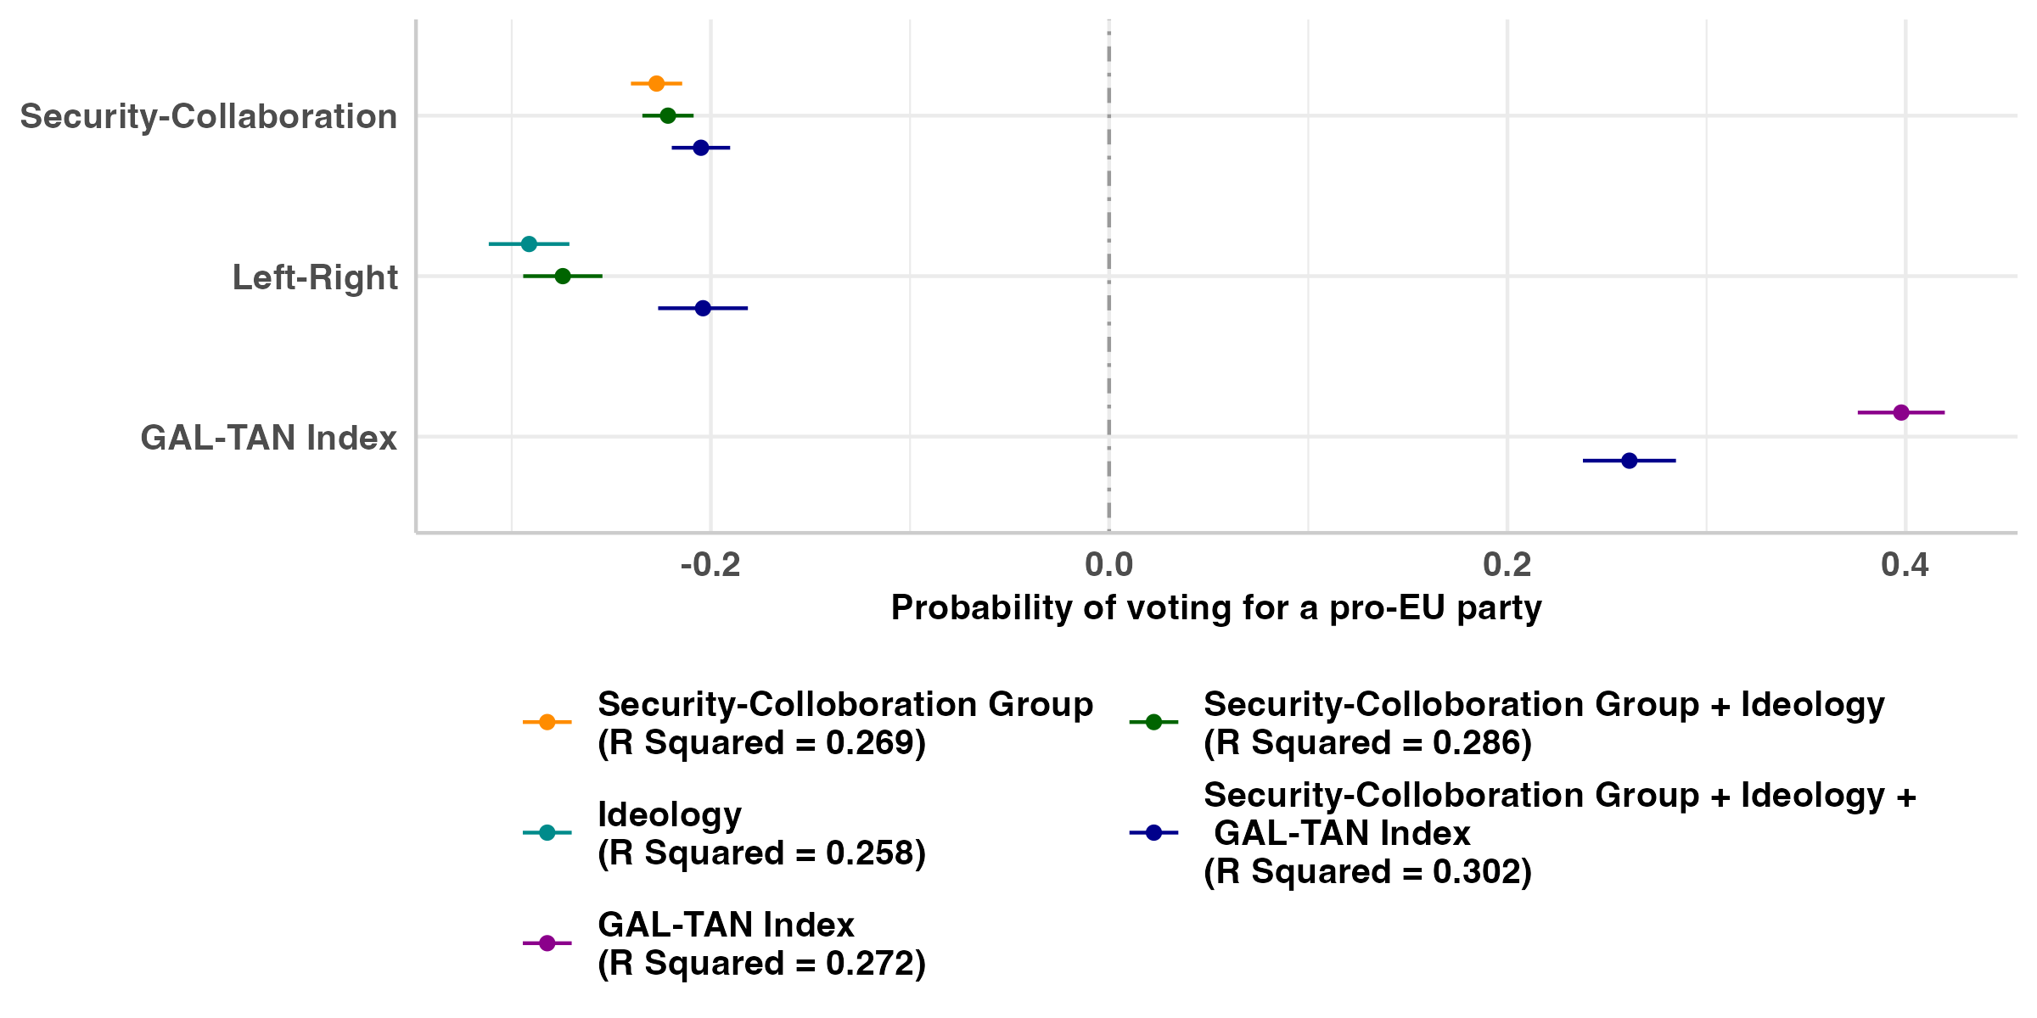
Expectation 4: Pro-EU Parties

Slide 32
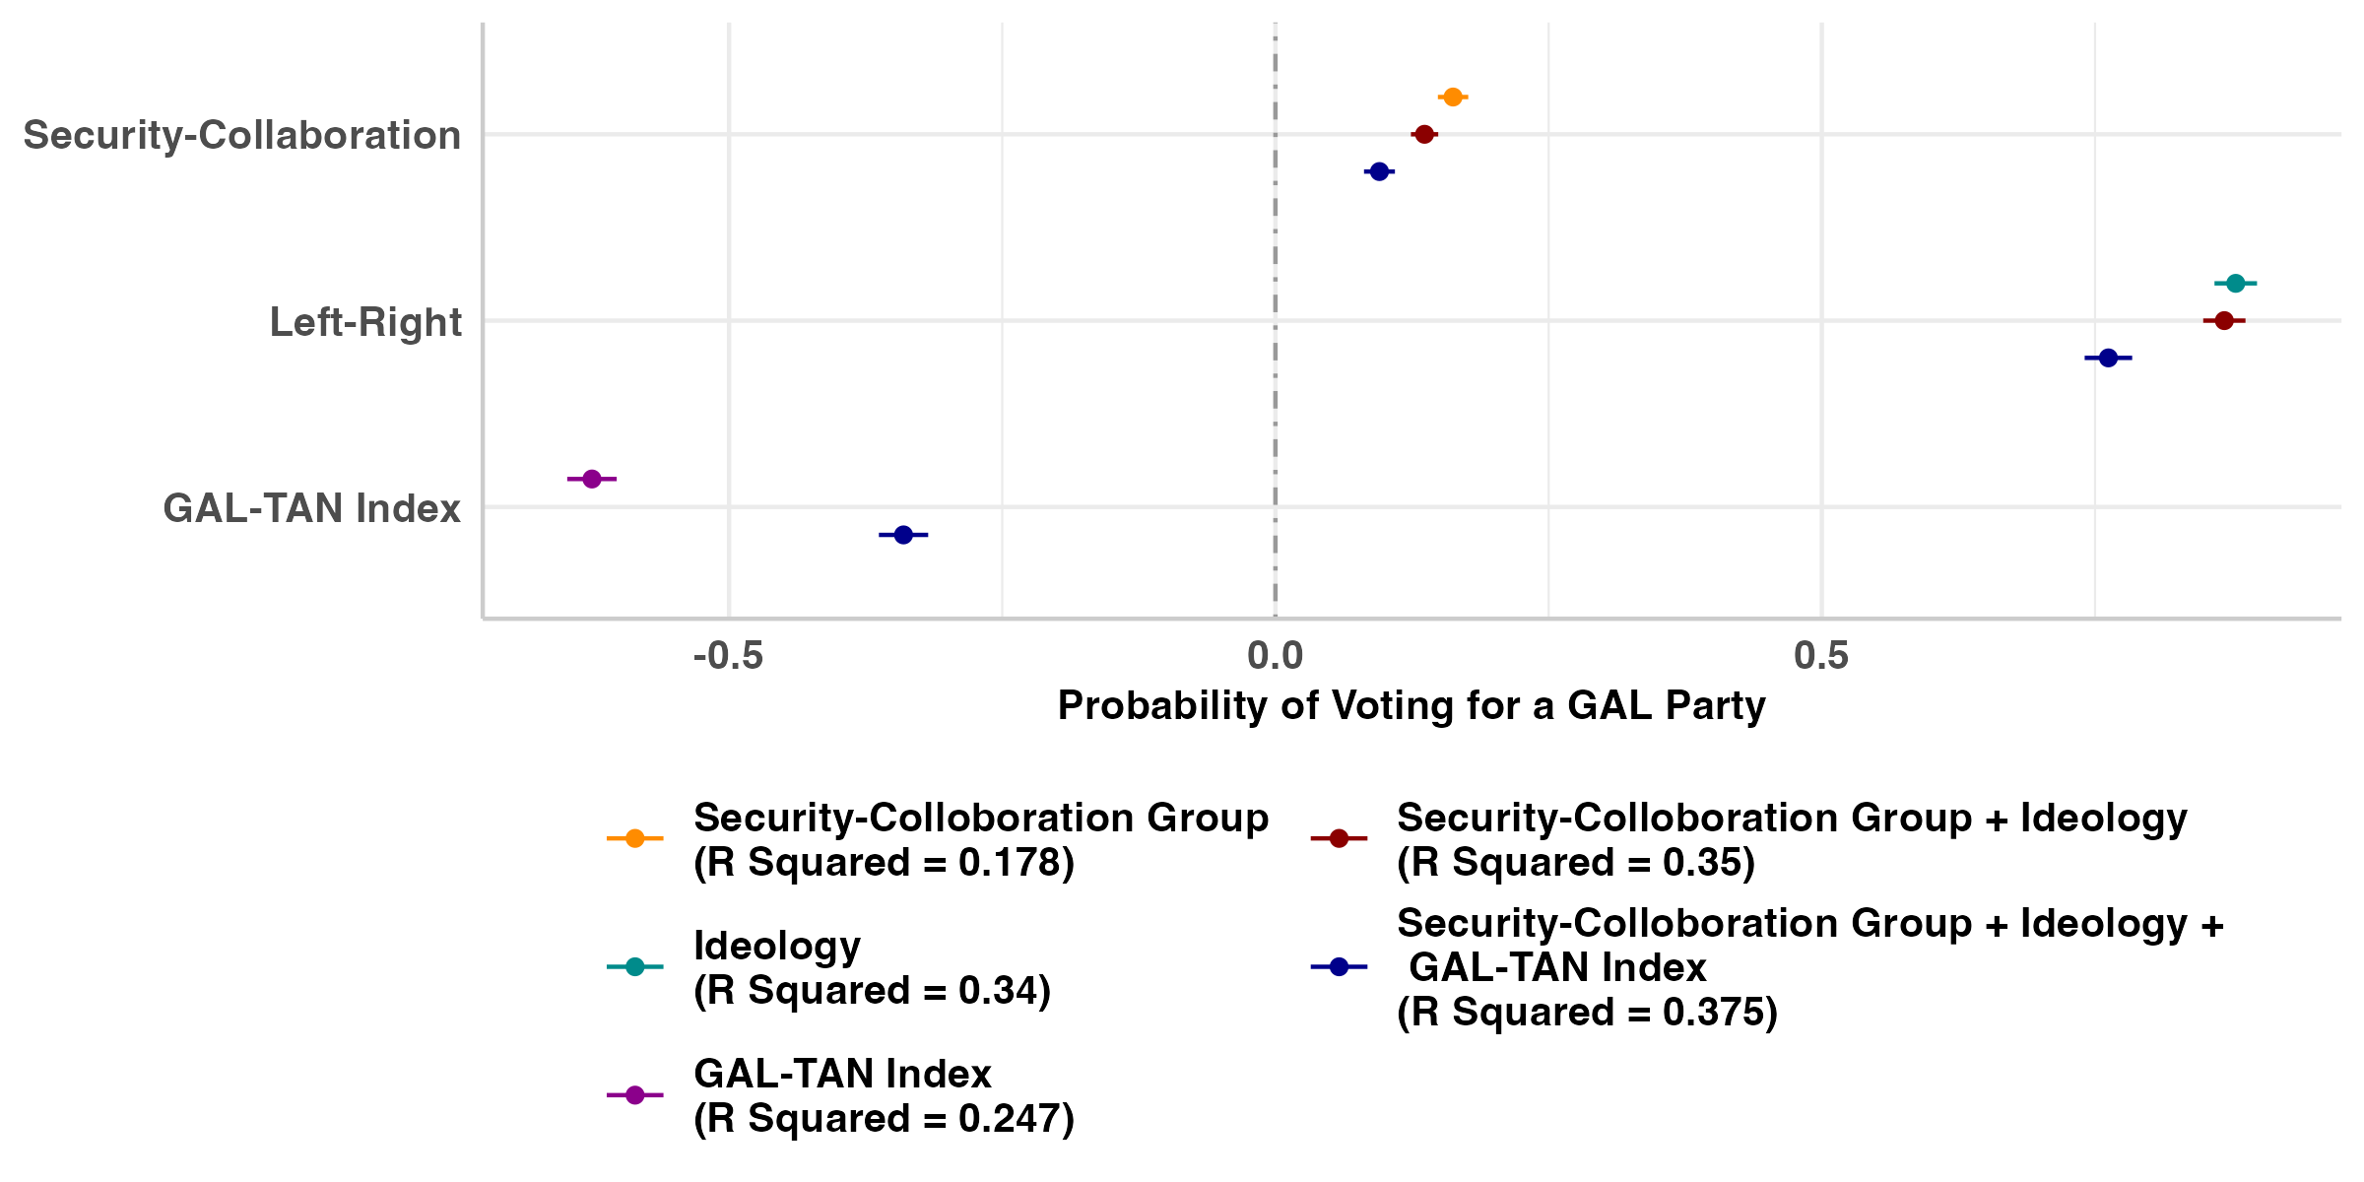
Expectation 4: GAL-TAN Parties

Slide 33
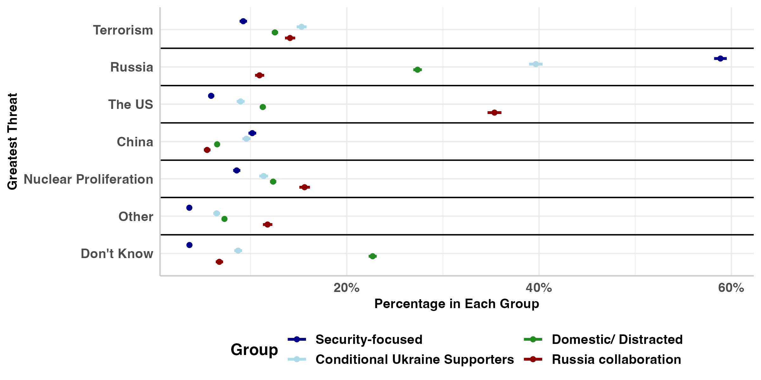
Expectation 2: Horizontal Coherence

Slide 34
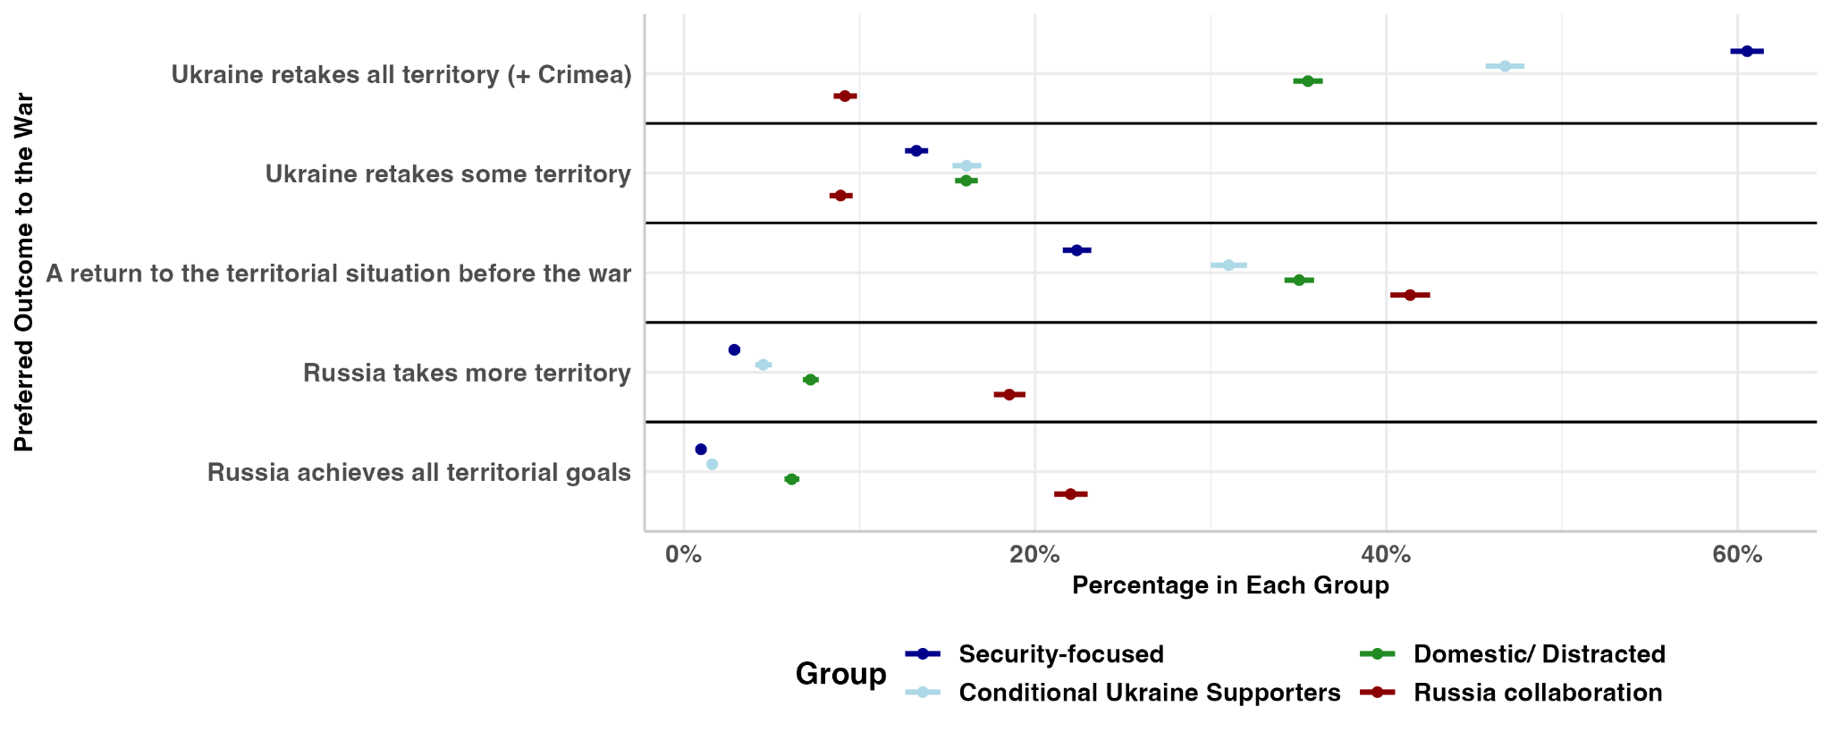
Expectation 2: Horizontal Coherence

Slide 35
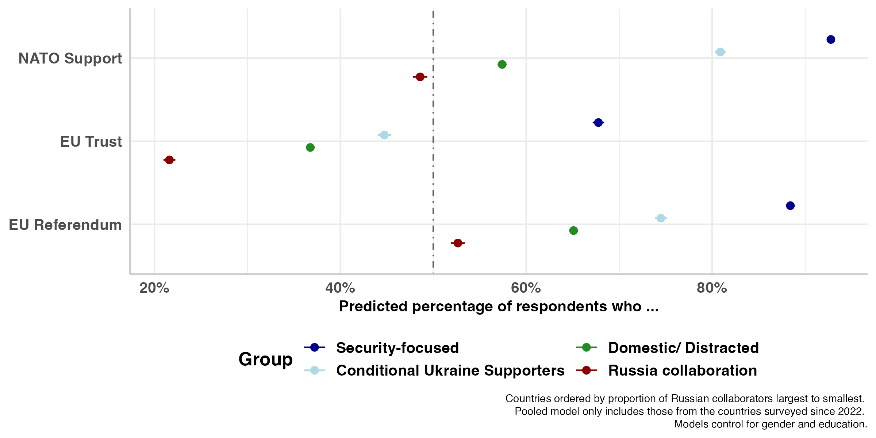
Expectation 3: Vertical Extension

Slide 36
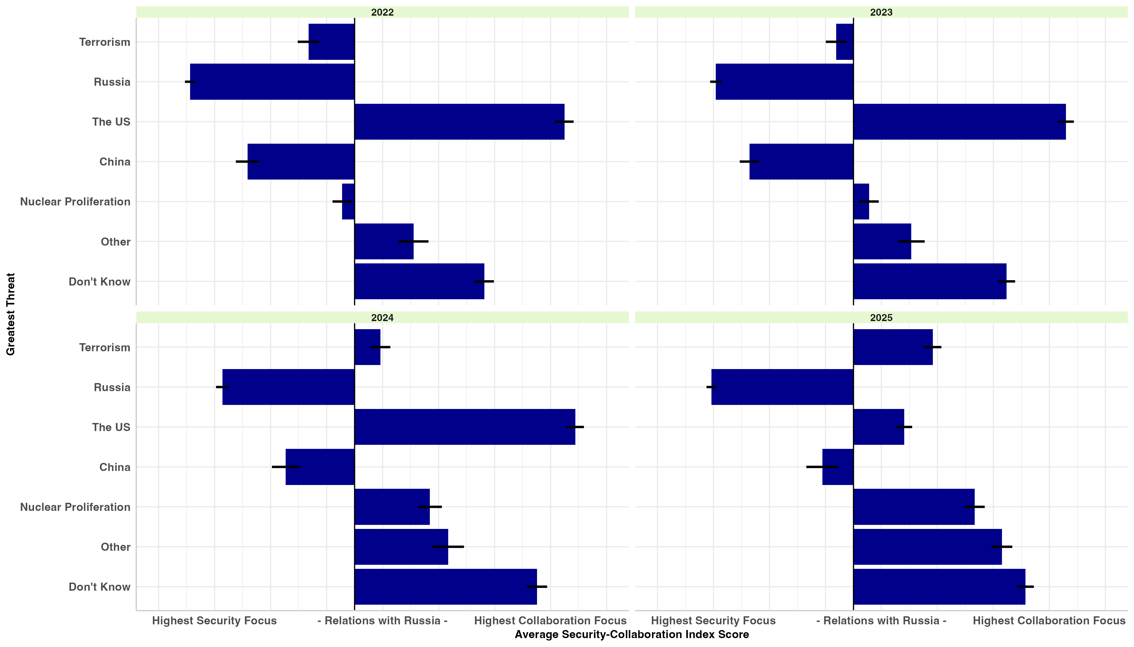
Expectation 2: Horizontal Coherence

